Slide 1
Testing Concepts
Testing Concepts Lab Book
Lab Book

Slide 2
Testing Concepts Lab Book
Table of Contents
Document Revision History ................................................................................................ 2
Table of Contents ............................................................................................................... 3
Lab 1. White-box Testing – Code Coverage & Complexity ........................................... 5
1.1 Read and understand the Code Coverage........................................ 5
To find no. of test cases required for 100% Code Coverage ............... 5
Method 1 : Draw Flow chart............................................................... 5
Method 2: Write Test Cases ............................................................... 6
What % of Coverage is achieved by given Test Case......................... 7 1.1.3 Complex Predicates ............................................................... 7 1.2 TO DO................................................................................... 7 1.2.1 Code snippet 1: .................................................................... 7 1.2.2 Code snippet 2 :.................................................................... 8 1.2.3 Code snippet 3 :.................................................................... 8 1.2.4 Code snippet 4 :.................................................................... 8
1.3 Validate the coding standards using Review checklist ........................ 9 1.4 Draw Flow Graph & Determine CC ................................................ 9
Lab 2. Black box Testing – BVA & ECP ........................................................................... 11
2.1 Determine ECP & BVA ............................................................. 11
2.2 Validate Command Line utility .................................................. 12
Lab 3. Black box Testing – Decision Table Tests ............................................................ 13
3.1 Decision Table 1 : .................................................................. 13
3.2 Decision Table 2 : .................................................................. 13
Lab 4. Black box Testing – State Transition Testing ........................................................ 14
4.1 Scenario 1 : .......................................................................... 14
4.2 Scenario 2 : .......................................................................... 14
Lab 5. Creating Test Scenario – EXCHANGE on WEB ................................................... 15
5.1: Test Scenario Case Study. Posting an Ad on “EXCHANGE on WEB (EoW)” 15 5.2: Steps to post an Ad.................................................................. 15
5.3 Rules: ................................................................................... 18
Lab 6. Creating Test Cases – Conference Room Booking .............................................. 19
6.1 Case Study. ‘ONLINE CONFERENCE ROOM BOOKING’ on Intranet ............ 19

Slide 3
Testing Concepts Lab Book
6.2 Booking Instructions ................................................................. 19
6.3 Making a new booking: .............................................................. 21
6.4 Viewing / Cancellation of Bookings: .............................................. 22
Lab 7. Creating Test Cases – Cyber Shoppee................................................................. 23
7.1 Case Study: CYBERSHOPPEE ...................................................... 23
7.2 Work Flow: .......................................................................... 24
7.2.1 Visit CyberShoppee Website ................................................... 24
7.2.2 Register ............................................................................ 24
7.2.3 Admin Module .................................................................... 25
7.2.4 Customer Module ................................................................ 27
7.2.5 Dealer Module .................................................................... 31

Slide 4
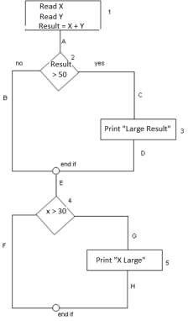
Testing Concepts Lab Book
Lab 1. White-box Testing – Code Coverage & Complexity
Goals | Learn to find out the Code Coverage Learn to determine Cyclomatic Complexity
Time | 180 Minutes
Read and understand the Code Coverage
To find no. of test cases required for 100% Code Coverage
Consider the below code snippet.
Read X
Read Y
Result = X + Y
IF Result > 50 THEN Print “Large Result” ENDIF
If X > 30 THEN
Print “X Large” ENDIF
Method 1 : Draw Flow chart

Slide 5
Testing Concepts Lab Book
Coverage Type | Route | No. of Test Cases Required
100% Statement Coverage | 1A-2C-3D-E-4G-5H | 1
100% Branch Coverage | 1A-2C-3D-E-4G-5H , 1A-2B-E-4F | 2
100% Path Coverage | 1A-2B-E-4F, | 4
 | 1A-2B-E-4G-5H,
 | 1A-2C-3D-E-4G-5H,
 | 1A-2C-3D-E-4F
Method 2: Write Test Cases
Number the statements as below :
Read X
Read Y
Result = X + Y
IF Result > 50 THEN
Print “Large Result”
ENDIF
If X > 30 THEN
Print “X Large”
ENDIF
For 100% Statement Coverage : 1 test case required
Test Case Id | Test Condition | Input | Output
1 | Result > 50 = TRUE X > 30 = TRUE | X=40, Y=20 | All statements 1, 2, 3, 4, 5, 6, 7, 8, 9 execute.
For 100% Decision Coverage : 2 test cases required
Test Case Id | Test Condition | Input | Output
1 | Result > 50 = TRUE X > 30 = TRUE | X=40, Y=20 | All statements 1, 2, 3, 4, 5, 6, 7, 8, 9 execute. TRUE side of both decisions tested
2 | Result > 50 = FALSE X > 30 = FALSE | X=20, Y=20 | Only statements 1, 2, 3, 4, 6, 7, 9 execute. FALSE side of both decisions tested
Note: Path Coverage can be found by drawing flow chart.

Slide 6
Testing Concepts Lab Book
1.1.2 What % of Coverage is achieved by given Test Case
Consider the same code snippet and flow chart discussed in sec 1.1. What % of coverage is achieved with the test case : X=20, Y=20.
Coverage Type | Covered Status | % of Coverage
Statement Coverage | There are total 5 statements in the flowchart. But only 3 statements are covered i.e. 1, 2, 4 statements are tested and 3, 5 are not tested. So, (3/5)*100 = 60% | 60%
Branch Coverage | There are total 4 branches/decisions in the flowchart. But only 2 branches/decisions are covered So, (2/4)*100 = 50% | 50%
Path Coverage | There are total 4 paths in the flowchart. But only 1 path is covered. So, (1/4)*100 = 25% | 25%
1.1.3 Complex Predicates
When a pseudocode with complex predicates is given, you can convert it into a pseudocode of simple predicates and then find the required code coverage.
Example :
complex predicate | Converted to Simple predicate
Read A If A > 0 and A < 5 Then Print “A” End If | Read A If A > 0 Then If A < 5 Then Print “A” End If End If
TO DO
Code snippet 1:
int x,y,z;
printF(“Enter three integers”);
3. scanF(“%d %d %d”, &x, &y, &z);
4. if(x>y && x>z) {
5. printF(“%d is greater”, x); 6. }
if(y>z) {
printF(“%d is greater”, y); 9. }
else{
printF(“%d is greater”, z)
12. }

Slide 7
Testing Concepts Lab Book
How many test cases are required to achieve 100% Decision coverage?
How many test cases are required to achieve 100% Statement coverage?
How many test cases are required to achieve 100% Path coverage?
1.2.2 Code snippet 2 :
IF THEN ELSE END IF IF THEN END IF
(thundering AND storms) OR night stay inside
go outside
bright sun go to beach
How many test cases are required to achieve 100% Decision coverage?
How many test cases are required to achieve 100% Statement coverage?
How many test situations have “go to the beach” as the result?
1.2.3 Code snippet 3 :
int result = a+ b;
If (result> 0)
Print ("Positive", result)
Else
Print ("Negative", result)
Find the % of Statement & Branch Coverage for the following test cases : 1. a=3, b=9
2. a= -3, b= -9
1.2.4 Code snippet 4 :
Read A, B, C
If A>B Then
Print (A/B)
End IF
If A>C Then
Print (A/C)
End IF
Find the % of Statement Coverage & % of Path Coverage for the following test cases: 1. A = 5, B = 10 and C = 2
2. A = 10, B = 10 and C = 10
3. A = 10, B =5 and C = 2
4. A = 2, B= 5 and C = 10

Slide 8
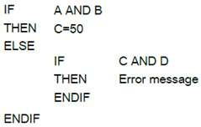
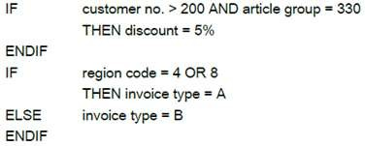
Testing Concepts Lab Book
1.3 Validate the coding standards using Review checklist
Note: You can make use of Code Review Check list explained in Lesson 02. You can also make use of sample template given below
Table: Template of Code Review Checklist
Sr. No. | Question | Remark (Yes / No)
Syntactical Errors
1 | Does every statement has a delimiter?
2 | Are the in-built functions spelled properly?
Data Declaration Errors
3 | Have all variables been explicitly declared?
4 | Are variables properly initialized in declaration sections?
Comparison Errors
5 | Are there any comparisons between variables having inconsistent data types?
Control Flow Errors
6 | Does every cause has an effect?
Input / Output Errors
7 | All Input statements handled correctly?
8 | All Output statements handled correctly?
1.4 Draw Flow Graph & Determine CC
Draw corresponding flow graph and find the cyclomatic complexity (CC) for the following specifications:
Specification 1 | Specification 2
Specification 3 | Specification 4

Slide 9
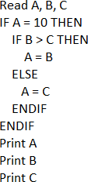
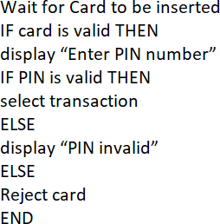
Testing Concepts Lab Book

Slide 10
Testing Concepts Lab Book
Lab 2. Black box Testing – BVA & ECP
Goals | Learn to apply basic techniques for writing test cases. Learn to prepare finite and best suitable test cases
Time | 120 Minutes
Determine ECP & BVA
‘X’ has given a data on a person age which should be between 18 and 99. Using BVA, find appropriate test cases.
In an Examination, a candidate has to score a minimum of 60 marks in order to clear the exam. The maximum that he can score is 100 marks. Identify the Valid Equivalence values if the student clears the exam.
Consider a scenario where a ‘Driver on Hire’ agency provides most reliable and affordable drivers on hire. The monthly salary structure configured for the drivers of this agency is : drivers up to 25 years old get a pay of Rs. 15000/- ; drivers of age 65 and older get a pay of 5% more and drivers of age 40 and older get a pay of 10% more than that of the drivers up to 25 years get. How many equivalence classes are distinguished in the above? Also, which values are chosen for making test cases when the normal variant of the boundary values analysis is used?
Consider a scenario where a ‘Winter Sale’ provides heavy discounts. A person he/she of age less than 8 years old (<8), or a person aged between 35 and 45 years (>35 and <45) or older than 60 years (>60) is eligible for the discounts in Winter Sale. How many equivalence classes can be distinguished in this example?
A wholesaler sells printer cartridges. The minimum order quantity is 5. There is a 20% discount for orders of 100 or more printer cartridges. Identify the test cases using various values for the number of printer cartridges ordered.
A company is going to provide their employees with a bonus which will be based on the employee’s length of service in the company. The bonus calculation will be zero if they have been with the company for less than two years, 10% of their salary for more than two but less than five years, and 25% for five to ten years, 35% for ten years or more. The interface will not allow a negative value to be input, but it will allow a zero to be input. How many equivalence partitions are needed to test the calculation of the bonus?

Slide 11
Testing Concepts Lab Book
2.2 Validate Command Line utility
Validate Command Line utility - ‘MAX’. This utility displays the maximum of the two specified Integers. Please note down any assumptions that you make.
E.g. MAX 2 3
Steps to run Max command line utility
create a folder demo on E drive
Copy max.exe file in to demo folder
Click on start > run. Type cmd
Type “E:”
Type “ cd demo”
Use following commands to run max utility
E:\demo> max 25 34 E:\demo> max 25 b E:\demo> max a 34 E:\demo> max 25.45 34.67

Slide 12
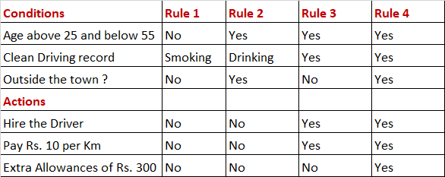
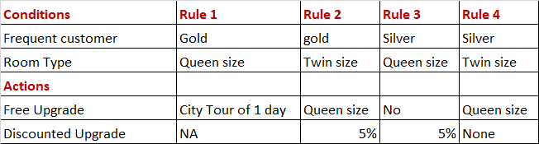
Testing Concepts Lab Book
Lab 3. Black box Testing – Decision Table Tests
Goals | Learn to apply basic techniques for writing test cases. Learn to prepare finite and best suitable test cases
Time | 30 Minutes
3.1 Decision Table 1 :
Consider the following Decision table for hiring a Driver.
What is the expected result for the following test cases?
TC1: A 26-year-old driver for travelling to outside the town with Smoking or drinking habits in his driving record.
TC2: A 52-year-old driver with a clean driving record for travelling to outside the town TC3: A 57-year-old driver with a clean driving record for travelling to outside the town
3.2 Decision Table 2 :
Consider the following Decision table for a Frequent Flyer.
What is the expected result for each of the following test cases?
TC1: Gold frequent customer, staying in Twin size room. TC2: Silver frequent customer, staying in Queen size room.

Slide 13
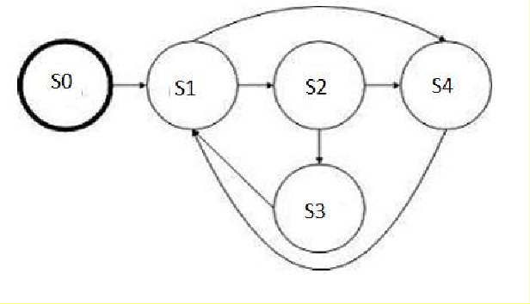
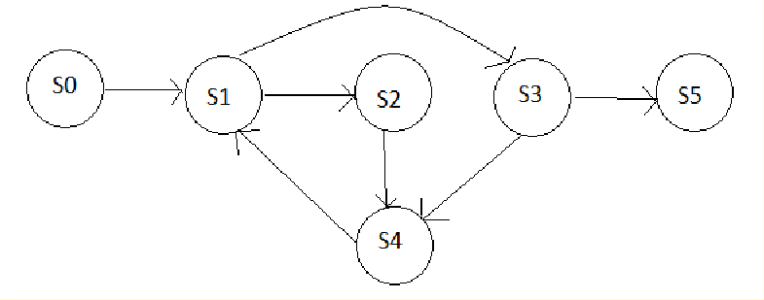
Testing Concepts Lab Book
Lab 4. Black box Testing – State Transition Testing
Goals | Read 'INSTRUCTIONS' before starting the assignment. Understand the application and develop Test Scenarios
Time | 30 minutes
4.1 Scenario 1 :
Consider the below state diagram.
Check which of the following tests are valid and which of them are invalid. A. S0-S1-S2-S3-S1-S4
B. S0-S1-S4-S1-S2-S3
C. S0-S1-S3-S1-S2-S1
D. S0-S1-S2-S3-S1-S2
4.2 Scenario 2 :
Given the Following state transition diagram, find the test case which covers minimum series of valid transitions to cover every state at least once.?

Slide 14
Testing Concepts Lab Book
Lab 5. Creating Test Scenario – EXCHANGE on WEB
Goals | Read 'INSTRUCTIONS' before starting the assignment. Understand the application and develop Test Scenarios
Time | 90 minutes
: Test Scenario Case Study. Posting an Ad on “EXCHANGE on WEB (EoW)”
www.eow.com is the most preferred online web application in India for exchanging/selling of old products. In this case study, customer posts and advertisement of his product on the EoW portal.
Participants need to write Test Scenarios for testing Buttons, Hyper Links, and Form fields.
Note: Trainer will discuss the Test Scenario template and will share the same with participants
: Steps to post an Ad
The customer visit https:\\www.eow.com site. To login, click on ‘Login with phone & OTP’. Login using Friendsbook account is out of scope.
The customer enters 10 digit mobile no and clicks on ‘Get OTP’. The application sends an OTP (One Time Password) on his phone no.
The portal asks for the OTP confirmation code. User can enter the code and
‘CONFIRM’ to continue or CANCEL it. If the user has timed out (at max. 60 sec) in typing the OTP code, he can click Resend code for receiving another OTP code.
The portal displays the home page. Customer clicks on ‘Submit a Free Ad’ to post a new add. Searching for products is out of scope.
Form of ‘Submit a Free Classified Ad’ is displayed. Fill all the details in the form and click ‘Submit’ button
The portal asks for the OTP sent on phone no. that is given while submitting the free classified Ad. User can enter the code and ‘CONFIRM’ to continue or CANCEL it. If the user has timed out (at max. 60 sec) in typing the OTP code, he can click Resend code for receiving another OTP code.
On entering correct OTP, it displays the message ‘Ad is successfully posted’ else it displays the message ‘Wrong Verification code! Ad is not posted’
Note: Refer the figures corresponding to the steps.

Slide 15
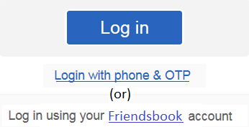

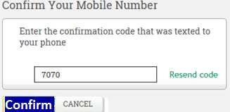
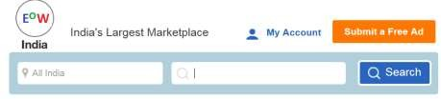
Testing Concepts Lab Book
Figure 1
Figure 2
Figure 3
Figure 4

Slide 16
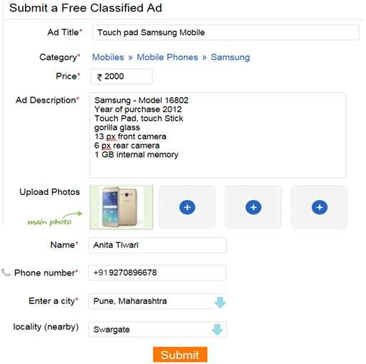
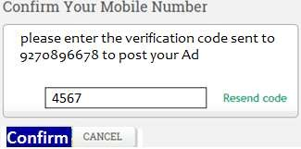
Testing Concepts Lab Book
Figure 5
Figure 6

Slide 17
Testing Concepts Lab Book
Rules:
The phone number should accept only 10-digit number
The OTP should accept only 4-digit number
The fields marked as * are mandatory fields on the form
Ad Title should accept maximum 70 characters and minimum 15 characters
The Category should accept only values given in following table
Category | Sub Category | Sub Category
Mobiles | Mobile phones | IPhone, Karbon, Lava, LG, Samsung, Micromax
 | Tablets | Asus, Samsung, Appel I Pad
Cars | Cars | Toyota, Chevrolet, Zen, Swift
 | Spare parts | Car glass, amplifier, Stereo system
 | Beds | Single bed, double bed
 | Wardrobes | Single door, two door, sliding door
Price accepts only digits in Rupees format
Ad Description should accept maximum 70 characters and minimum 15 characters
Upload Photos should allow browsing the pictures from your local machine. Minimum one photo should be uploaded.
Name should accept only characters
Select the City from the drop down box. This will automatically populate the Loacality based on the selected City. Refer the below given table for sample valid values of Cities and Localities combination.
City | Locality
Pune, Maharashtra | Swargate
 | Hinjewadi
 | Shaniwarwada
Banglore, Karnataka | Whitefield
 | Mathalli
 | Bujgiri
Mumbai, Maharashtra | MG Road
 | Dadar
 | Nalasopara

Slide 18
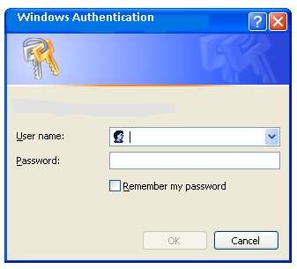
Testing Concepts Lab Book
Lab 6. Creating Test Cases – Conference Room Booking
Goals | Read 'BOOKING INSTRUCTIONS' before starting the assignment. Understand the application and develop creative test cases.
Time | 120 minutes
Case Study. ‘ONLINE CONFERENCE ROOM BOOKING’ on Intranet https://intranet.cgcrbIndia.com is the most preferred online link to book a conference room in Indian Capgemini locations.
Participants need to write Test Cases covering for testing Buttons, Hyper Links, and Form fields.
Note: Trainer will discuss the Test Case template and will share the same with participants.
Booking Instructions
Invoke intranet by typing the URL https://intranet.cgcrbIndia.com
Login using id and password
Intranet home page is displayed
Select Employee Corner and Click on Conference Room Booking option

Slide 19
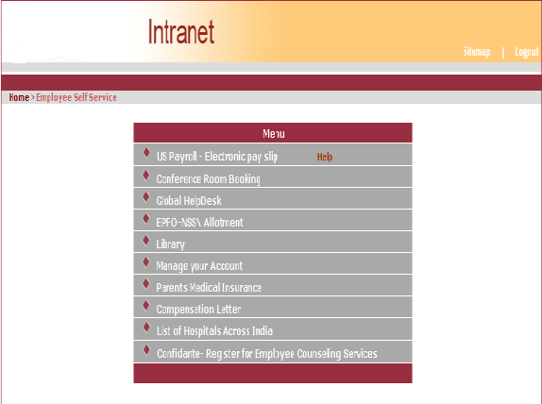
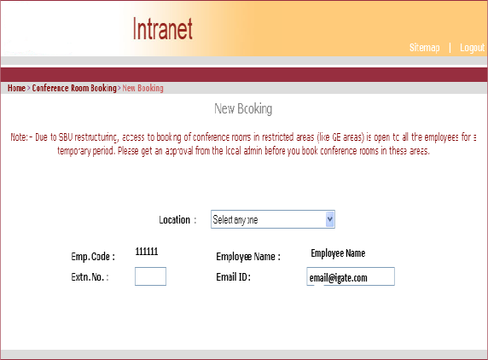
Testing Concepts Lab Book
Intranet home →Employee Corner →Conference Room Booking
'My Bookings' option on the Conference Menu Page displays the View / Cancel Booking Page.
'New Booking' option on the Conference Menu Page displays the Conference Booking Page.

Slide 20
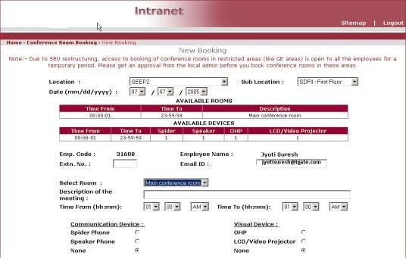
Testing Concepts Lab Book
6.3 Making a new booking:
If you belong to a Non-GE Business Unit, you can book conference rooms only in Non- GE areas. However if you belong to a GE Business unit, you can book conference rooms at any location.
The employee Email id field is automatically filled with the email id of the person logged in.
Select the location from drop down box. This will automatically populate the sub- locations under the selected location in a new drop down box.
Select the sub-location from the sub-location drop down box. This will automatically populate the date drop down boxes.
Select the month from the month drop down box. Booking of conference rooms can be done only one month in advance. The date drop down boxes will be appropriately populated for this.
Select the date from the date drop down box,
Select the year from the year drop down box.
Upon selecting a valid location, sub location and date the complete Conference Room booking form is displayed
The rooms and devices available at the selected sub-location will be displayed in tabular format.
Enter your extension number and email id if it is not displayed correctly.
Select the room from the room drop down box.

Slide 21
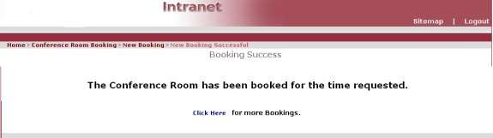
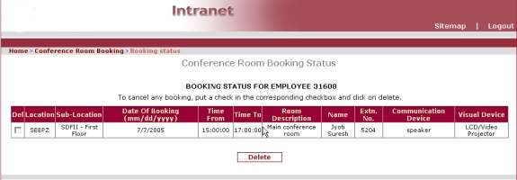
Testing Concepts Lab Book
Select the time span for which you want to book the conference room.
Select the communication and visual device if required.
Clicking 'Submit' button would validate whether the room and devices requested are available in the time span specified.
If either the room or devices requested are not available in the time span selected, an appropriate error message will be displayed else the booking will be registered. An email will be sent to you as a confirmation for the same.
If booking is successful, the following screen is displayed
The booking status is also shown under My Bookings as shown below:-
HOME →Conference Room Booking → Booking Status
Viewing / Cancellation of Bookings:
All the booking made by you for current and future dates will be displayed.
Select the bookings you wish to delete and then click the 'Delete' button.

Slide 22
Testing Concepts Lab Book
Lab 7. Creating Test Cases – Cyber Shoppee
Goals | Read the “CyberShoppee” System documentation before starting the assignment. Develop creative test cases for the CyberShoppee Online Shopping website.
Time | 180 minutes
7.1 Case Study: CYBERSHOPPEE
“CyberShopee” is a web based application and can be accessed over the internet. Using this application a user can shop online for different products.
This online shopping website facilitates user to shop various products such as TV, Camera etc. belonging to different categories.
Following is the complete list of functionalities of the system. You can make appropriate assumptions wherever necessary and proceed.
There are four categories of users who would access the system viz. Admin, Customer, Dealer and Delivery user. Each one of these users would have some exclusive privileges to be exercised on this website.
Note: Delivery user is out of scope. Functionalities of Admin :
1.
2.
3.
4.
5.
6.
Register on the website Login
Approve Dealer Approve Agency Add Category Add Sub Category
Functionalities of Customer :
1.
2.
3.
4.
5.
6.
7.
Register on the website Login
View Product Details Purchase Products Place the Order view Account Change Password
Functionalities of Dealer :
1.
2.
3.
4.
Register on the website Login
Add Agency
Perform Dealer Operations

Slide 23
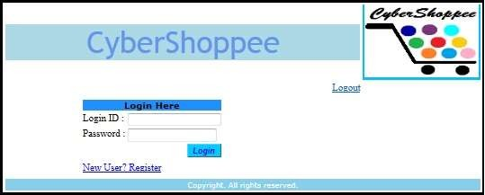
Testing Concepts Lab Book
Note: All operations are allowed only for the registered users.
Once the Order is confirmed, Cyber Shoppee will deliver the ordered products to the customer on his address specified during the registration. The Payment mode will be Cash on Delivery, Debit Card, Credit Card, Net Banking etc.
Work Flow:
Visit CyberShoppee Website
Visit https://cyberShopeesystem.com link through internet. This will take the user to the Home page of the website as given below. Refer to Figure 1.1.
Figure 1.1 CyberShopee Home Page
7.2.2 Register
Purpose | To register with CyberShopee website
Functionality | User can register on the website.
As mentioned earlier, the user need to register on the website to avail different facilities provided. The user needs to fill in the registration form to do so. Refer to the Figure 1.2. Once the user has been successfully registered on the website, he can login to the website with the registered username & password and proceed.

Slide 24
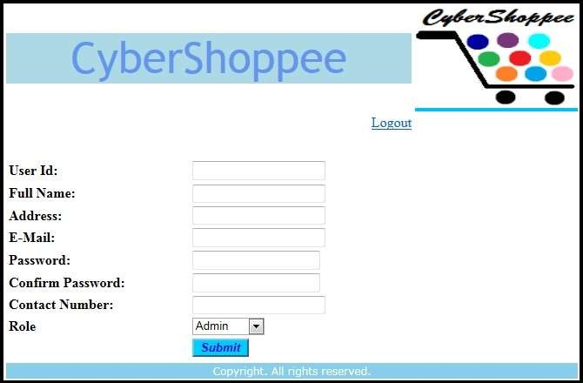
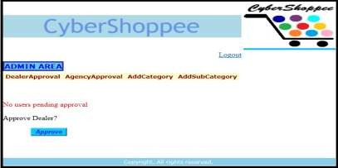
Testing Concepts Lab Book
Figure 1.2 Register
Requirements:
All fields are mandatory.
User Id should contain only 6 characters.
Full Name should contain upt0 30 characters and begin with uppercase letter.
Address should contain 200 alphanumeric characters.
Email should accept only valid email address e.g. someone@gmail.com
Password should contain at least one uppercase character and one special character.
Contact Number should contain only 10 digits and begin with 7/ 8/ 9.
Role should be populated with these options (Admin, Customer, Dealer and Delivery).
7.2.3 Admin Module
Note: Dealer approval and Agency Approval not in scope.
Figure 1.3 Admin Home Page

Slide 25
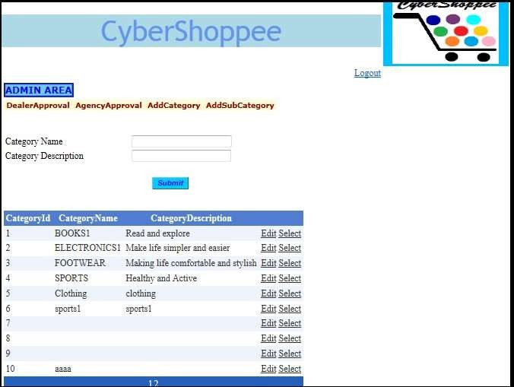
Testing Concepts Lab Book
a. Add Category
Figure 1.4 Add Category Page
Purpose | To add product categories
Functionality | Admin can add product category Admin can edit product category Admin can update product category
Requirements:
Category Name and Category Description cannot be blank.
Admin can edit any information of existing category & it should be successfully updated.
b. Add Sub Category

Slide 26
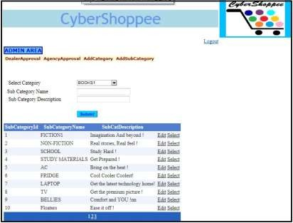
Testing Concepts Lab Book
Figure 1.5 Add Sub Category Page
Purpose | To add product sub category
Functionality | Admin can add product sub category Admin can update product sub category
Requirements:
The select category dropdown box is auto populated with the existing category ids.
User needs to select category id
User needs to fill in the subcategory name and subcategory description & both fields cannot be left blank.
Admin can edit any information of a product subcategory using same page.
User need to click on the “Edit” link to update the details of existing subcategory.
Once user has edited the details, he can confirm the same by clicking on Update link.
Customer Module
Search Products

Slide 27
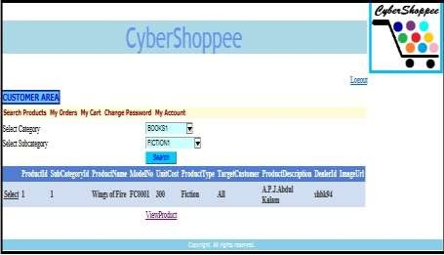
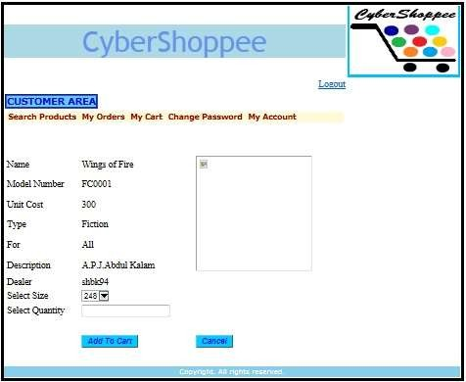
Testing Concepts Lab Book
Figure 1.6 Search Product Page
Figure 1.7 Add To Cart Page
Purpose | To search product
Functionality | Customer can search for a product Customer can then add the searched product in the shopping cart

Slide 28
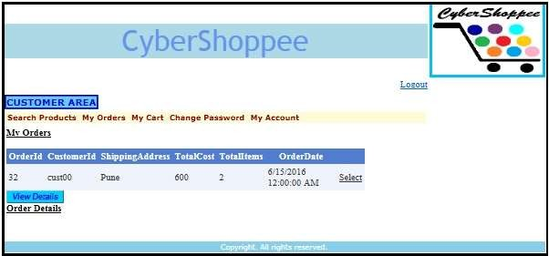
Testing Concepts Lab Book
Requirements:
Customer need to select the category.
Based on category selected the subcategory will be populated.
Customer need to click on the Search button to initiate the search of the product.
If the matching product exists, the details will be displayed in the table below.
Customer can click on View Product link to view the selected product and at the same time he can also add this product to the cart by clicking on the Add to Cart button.
When user clicks on “Add to Cart” button, product gets added in to the cart.
Select Quantity field cannot be null.
When user clicks on “Cancel” button user should navigate to Search Product page.
b. My Orders
Figure 1.8 My Orders Page
Purpose | To view orders
Functionality | Customers can view orders placed by him
Requirements:
Customer can click on My Orders tab to view his orders.
If the cart is null, and user clicks on “Place Order” Button, the order should not get added into My Orders.
c. My Cart

Slide 29
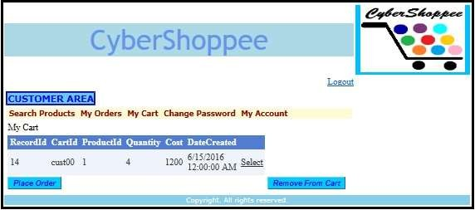
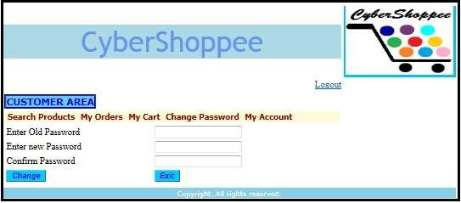
Testing Concepts Lab Book
Figure 1.9 My Cart Page
Purpose | To view products in cart and place order
Functionality | Customer can add products in cart Customer can place order
Requirements:
Customer can place order for selected items form the cart.
Customer can remove selected items form the cart.
d. Change Password
Figure 1.10 Change Password Page
Purpose | To change password
Functionality | Customer can change password

Slide 30
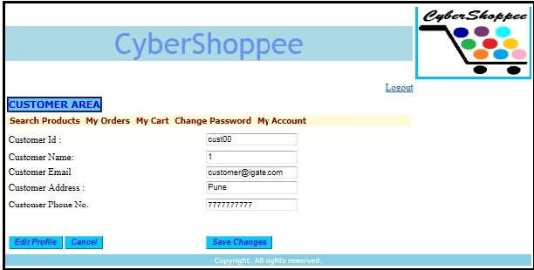
Testing Concepts Lab Book
Requirements:
Customer can click on “Change” button and change the password.
Customer can click on “Exit” button to come out from current page and navigate to customer’s home page.
New password and Confirm password should match with each other.
If Old password is incorrect, system should alert customer with proper error message.
e. My Account
Figure 1.11 My Account Page
Purpose | To Edit account Details
Functionality | Customer can edit his account details.
Requirements:
Customers are restricted to edit “Customer Id”.
Customer Name should contain only characters and begin with uppercase letter.
Email should be in someone@gmail.com format.
Contact Number should contain only 10 digits and begin with 7or 8 or 9.
Customer can click on “Edit profile” to edit the profile.
Customer can click on “Save Changes” button to save edited profile.
Customer can click on “Cancel” button to cancel the changes and should navigate to Customer Home page.
Dealer Module
Dealer Operations

Slide 31
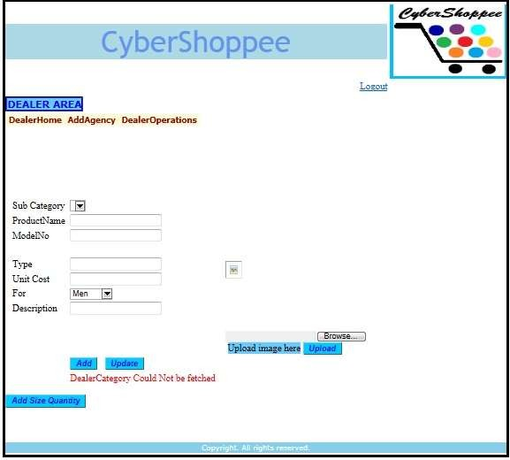
Testing Concepts Lab Book
Figure 1.12 Add Product Details
Purpose | To add product details
Functionality | Dealer can add product details. Dealer can update product details.
Requirements:
All fields are mandatory.
Sub category dropdown box should auto populate.
Product Name can be alphanumeric.
Model Number can be alphanumeric.
Unit cost should contain only digits.
Description should contain 100 characters.
Dealer can click on browse button and able to upload the image.
Dealer can click on “Add” button to add the products.
Dealer can click on “Update” button to update the products.
Dealer can click on “Add Size Quantity” button to add the product quantity.

